Slide 1
Social Acceptance of Nomadic Virtual Reality
Forschungsseminar: MMI

Slide 2
Project Summary
The study´s topic is to find out more about the „Acceptance of Nomadic Virtual Reality“ in public places based on previous researches by performing a field study.

Slide 3
Method
Study Design
Independent Variable:
Gender of the actor
VR goggles / no VR goggles
Gestures / no gestures
Location, Time
Dependent Variable:
- Acceptance Rating

Slide 4
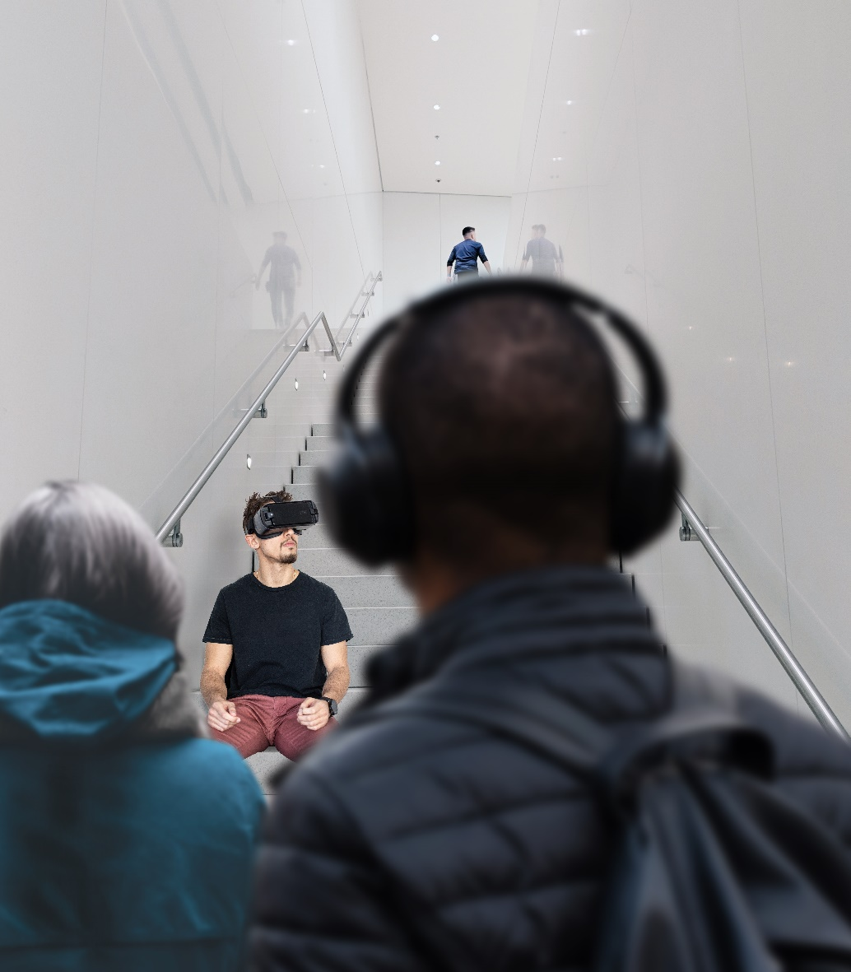
Method
Apparatus / Prototype

Slide 5
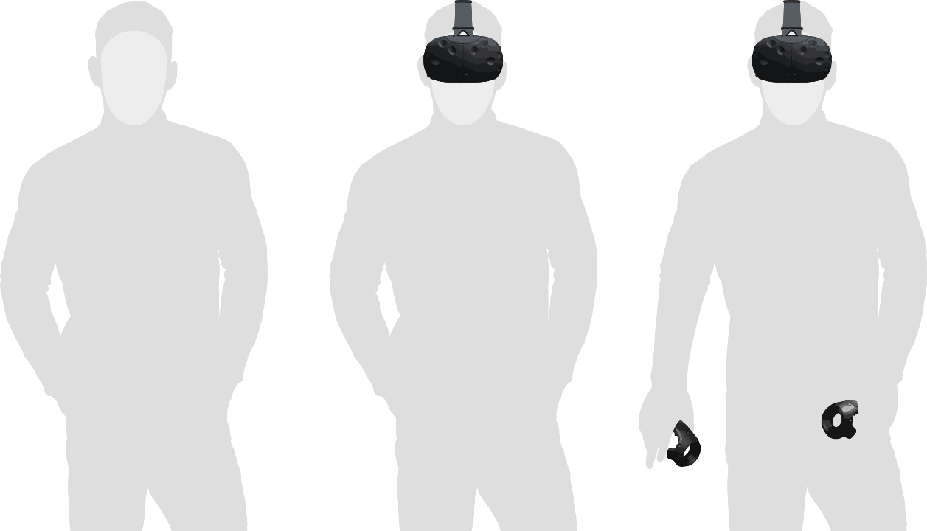
Method
Stimuli / Conditions

Slide 6
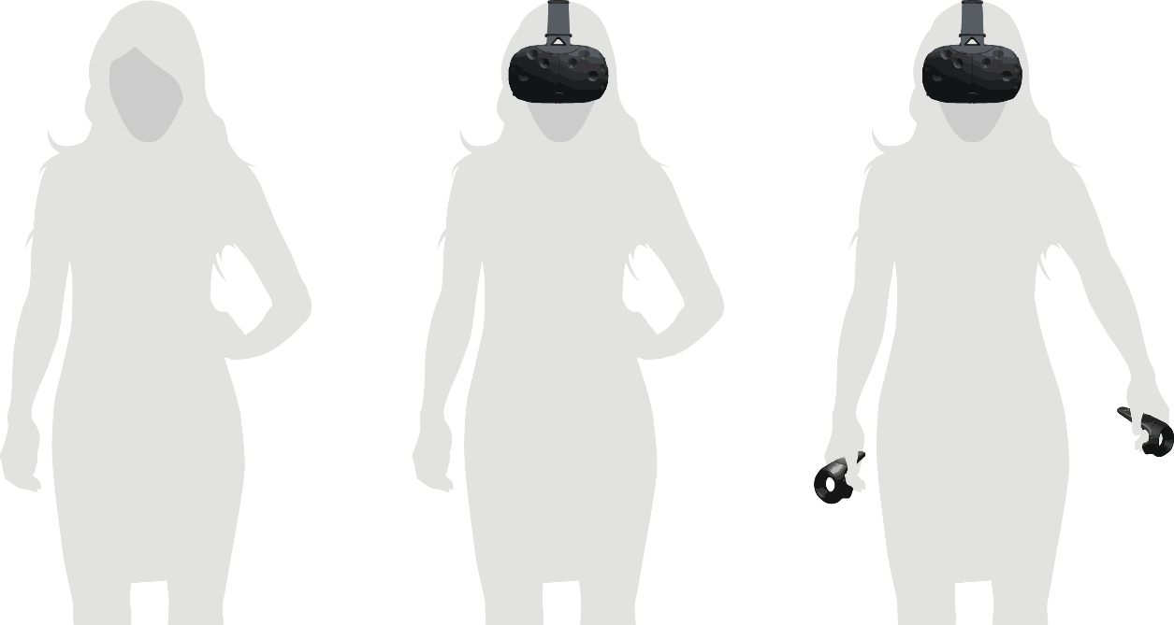
Method
Stimuli / Conditions

Slide 7
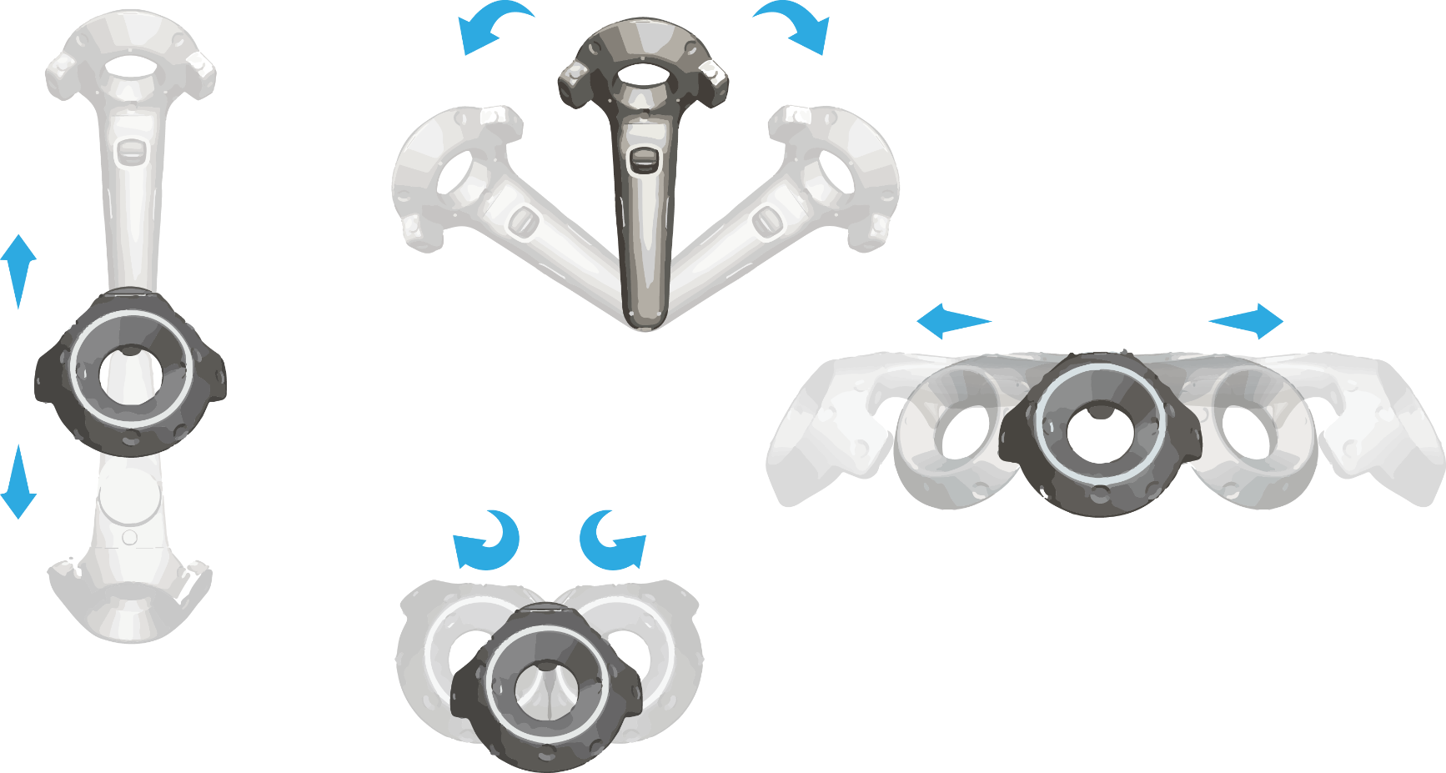
Gestures

Slide 8
Method
Procedure / Participant Recruiting
Actor / actress enters the chosen location and takes a seat
Let the situation act on nearby passerby
Interview nearby passerby
Each passerby fills out a demographic questionaire and a consent form
Each passerby fills out an „Acceptance Questionaire“
Hand out a reward
Each nearby passerby is a potential test person of our study

